Slide 1
Búkolla
THE ENGLISH VERSION OF THE ICELANDIC STORY

Slide 2
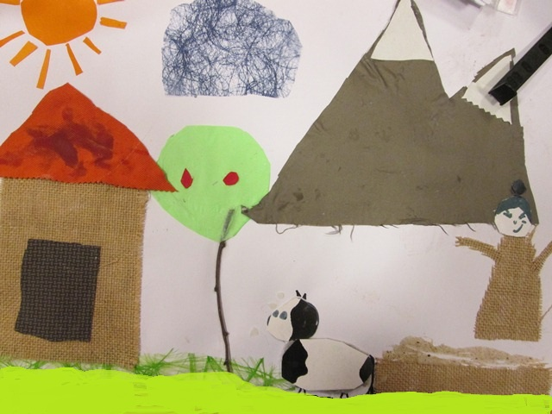
Once upon a time there lived a couple in a cottage. They had one boy and a cow. The cows name was Búkolla.

Slide 3
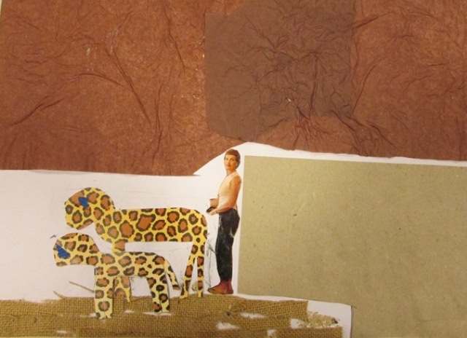
Búkolla gave birth to a little calf and the woman stayed with her. After the little calf was born the woman ran into the house to tell the others. When they came back the cow had disappeared.

Slide 4
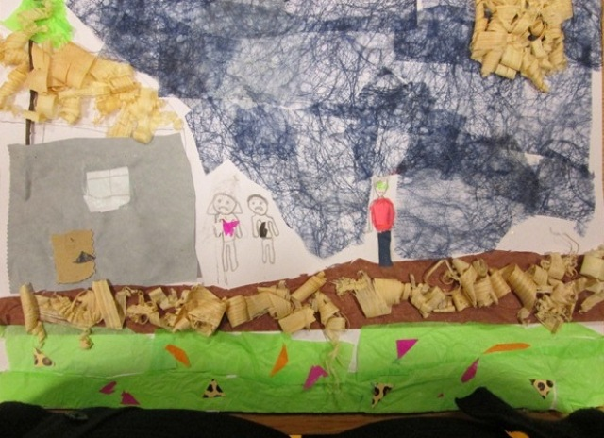
They looked everywhere but couldn´t find her. Then they sent the boy out to look for her and told him not to bother to come back if he couldn´t find her.

Slide 5
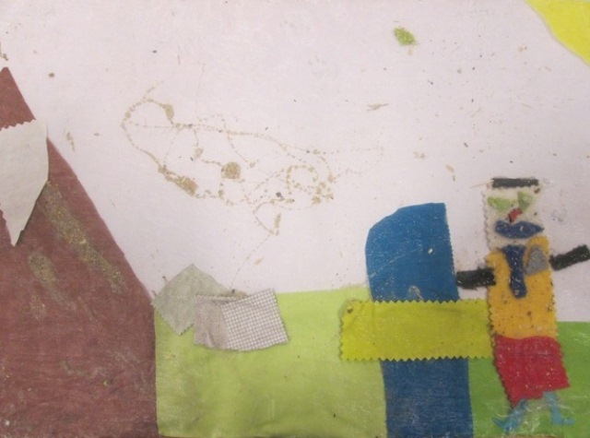
He walked for a long time until he became hungry and sat down to eat. In his desperation, he said out loud, „Moo now, my dearest Búkolla, if you are anywhere alive.“ From far, far away, he heard the cow’s response. Again, the boy walked for a long time before he sat down to have another bite. Then he repeated, „Moo now, my dearest Búkolla, if you are anywhere alive.“ This time he heard the cow a little closer than before. Once more the boy walked for a long time until he reached the top of a high mountain. As he had walked a long time, he sat down to eat, again saying as before, „Moo now, my dearest Búkolla, if you are anywhere alive.“

Slide 6
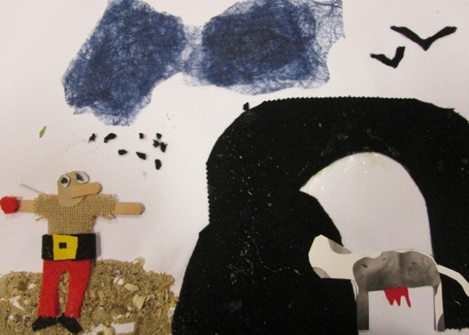
The cow’s response now came from right under his feet. The boy ran down the mountain and found a big cave. He went in, and there he found Búkolla, bound to the wall. He untied the cow immediately, led her out, and set off back home.

Slide 7
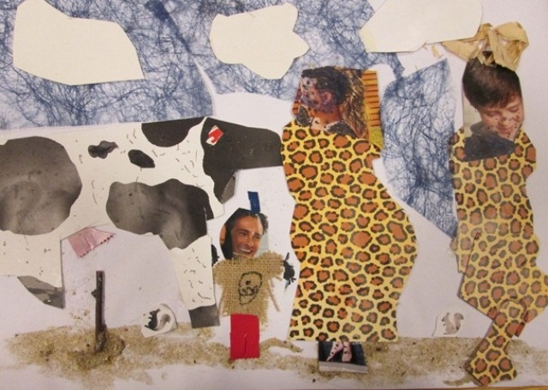
When they had walked for a while they heard loud noises. They looked back and saw a big ogress and a smaller ogress running after them.

Slide 8
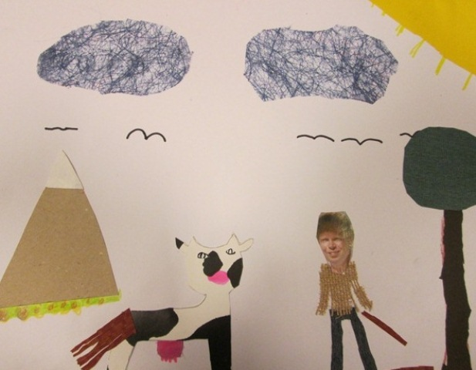
The boy said, “What are we to do now, my dearest Búkolla?“. “Pick a hair from my tail, and put it on the ground,“ the cow answered.

Slide 9
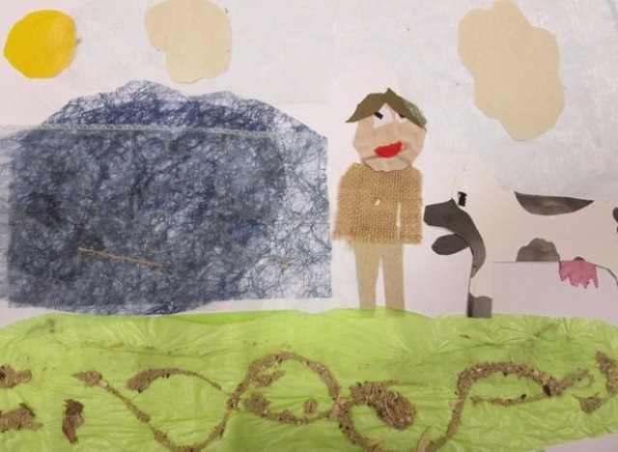
He did. The the cow said to the hair, “By these words I lay the spell that you become a stream so large that no one can cross it but the flying bird.“ Immediately, the hair turned into a huge stream.

Slide 10
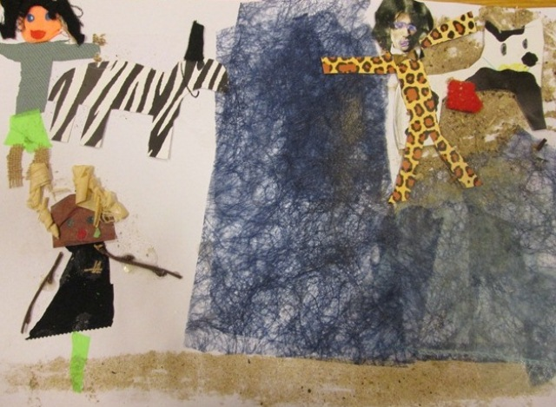
When the ogress reached the stream, she said, “You won’t get away with that, my boy.“ And she said to the small ogress: “Run, run home girl and get your father’s big bull.“ The small one ran off and soon returned with an enormous bull, which right away drank the whole stream.

Slide 11
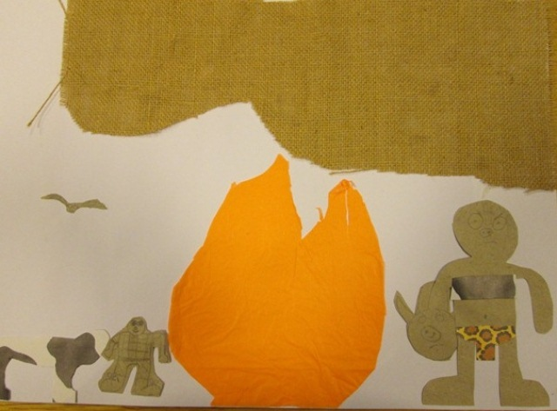
Again, the boy feared that the ogress would catch them very quickly and he said, „What are we to do now, my dearest Búkolla?“ “Pick a hair from my tail, and put it on the ground.“ Then Búkolla said to the hair “By these words I lay the spell that you become a fire so hot that no one can cross it but the flying bird.“ As soon as she had spoken, the hair turned into a big fire.

Slide 12
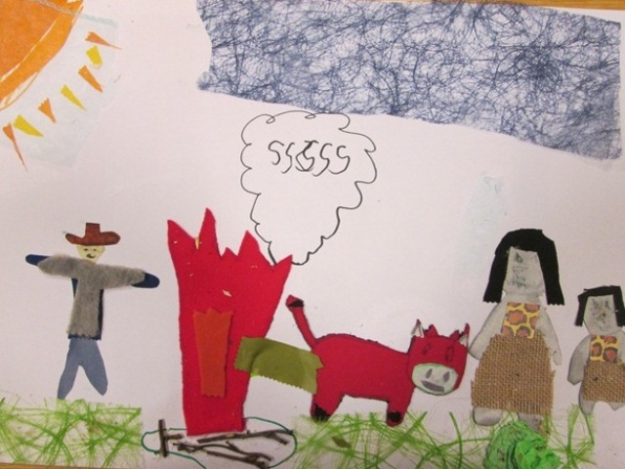
When the big ogress reached the fire she shouted, “You won´t get away with that, my boy.“ And to the small ogress she said, “Go get your father’s big bull, girl.“ The girl did and returned with the bull, which then pissed all the water it had drunk from the stream and put out the fire.

Slide 13
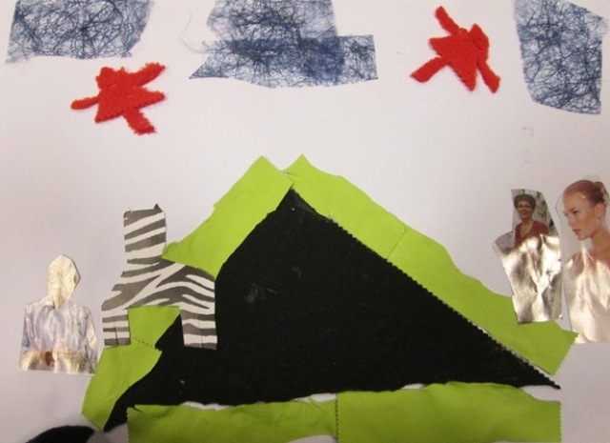
Once more, the boy saw that the ogress would catch up with him very soon and he said, „What are we to do now, my dearest Búkolla?“ “Pick a hair from my tail, and put it on the ground,“ she said. Then, to the hair, “By these words I lay the spell that you become a mountain so high that no one can go over it but the flying bird.“ The hair immediately turned into such a huge mountain that the boy could only see straight up into the sky.

Slide 14
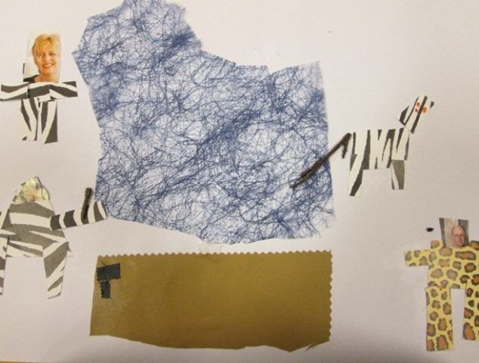
When the big ogress came to the mountain, she screamed, “You won´t get away with that, my boy.“ To the small ogress she said, “Go get me your father’s big drill, my girl.“ The small one ran home and returned with the drill. The big ogress then drilled a hole straight through the mountain.

Slide 15
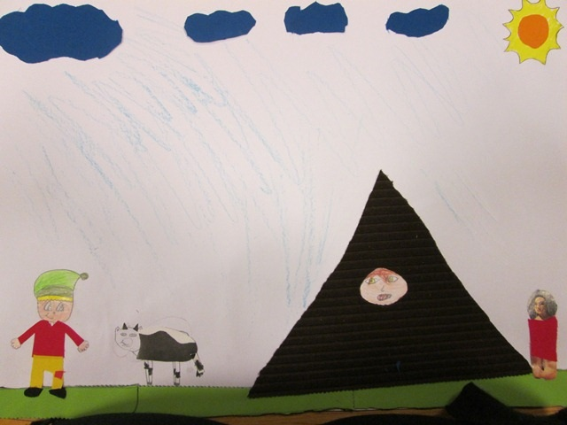
When she could see through it, she started to squeeze herself into the hole. But it was too narrow for her and she got stuck. Finally, she turned into stone right there in the hole. And that’s where she still is today.

Slide 16
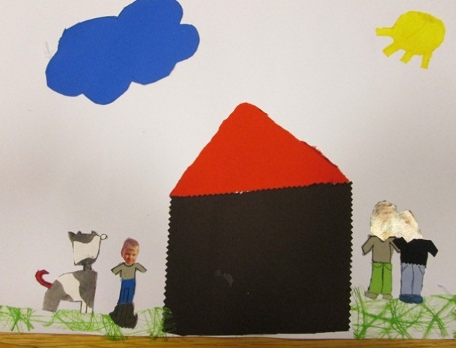
As for the boy, he reached the cottage safe and sound with his Búkolla, and the couple was very happy to have them both back.

